Slide 1
Processing Results
10/28/2018

Slide 2
Processing Accuracy
Using default (10m) camera accuracy allows for error to propagate into camera EO
Refraction Tiepoint Error -> Camera Position -> 3D Pointcloud Elevation

Slide 3
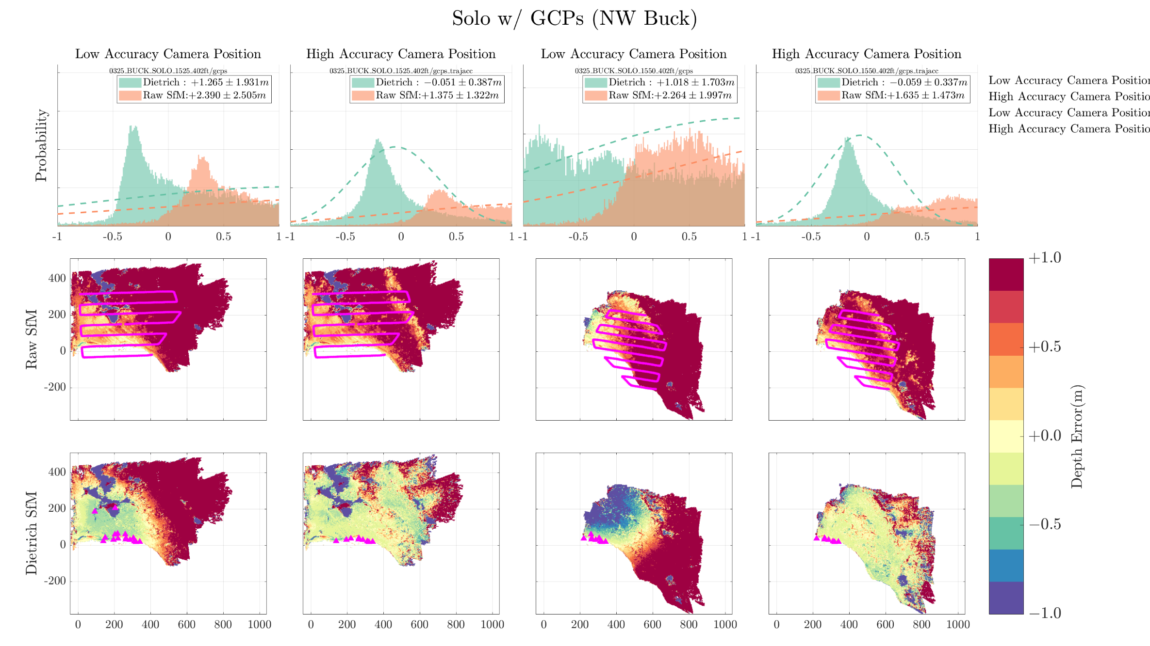

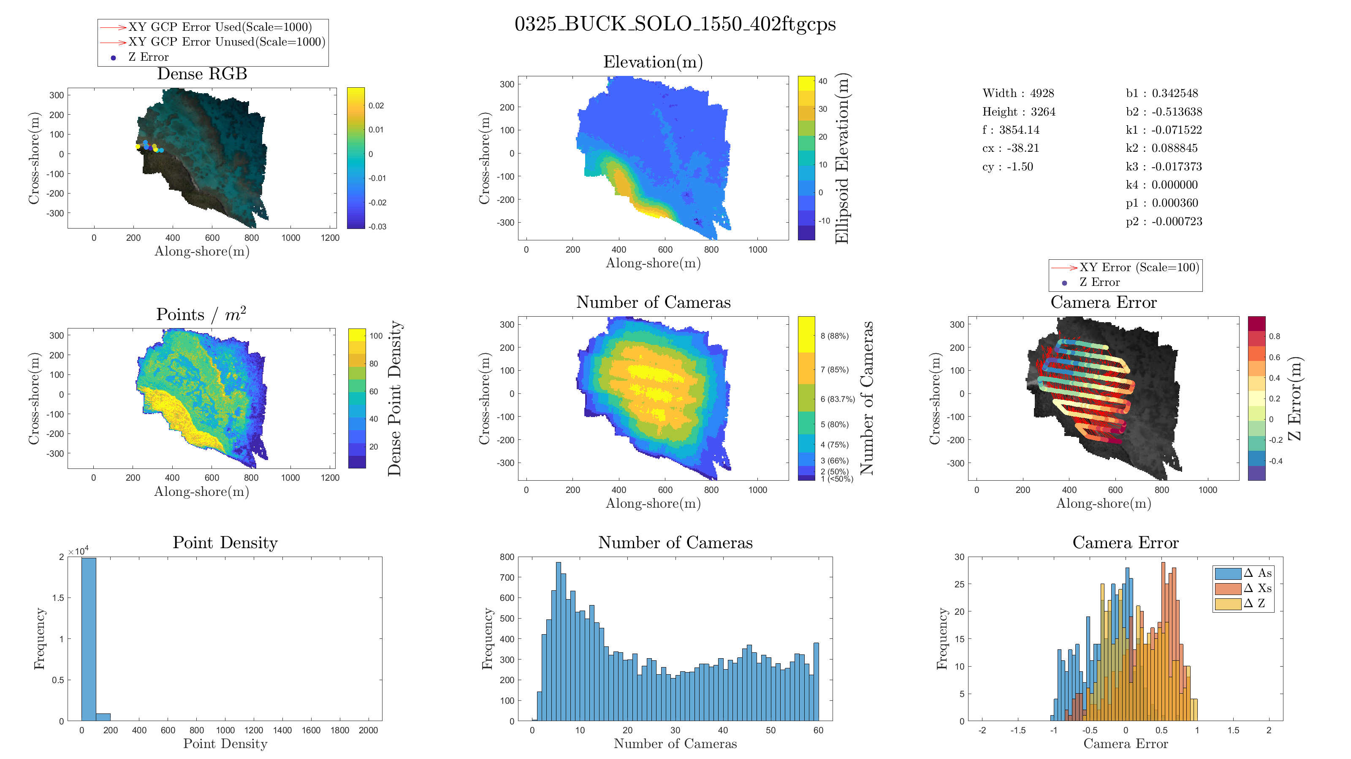
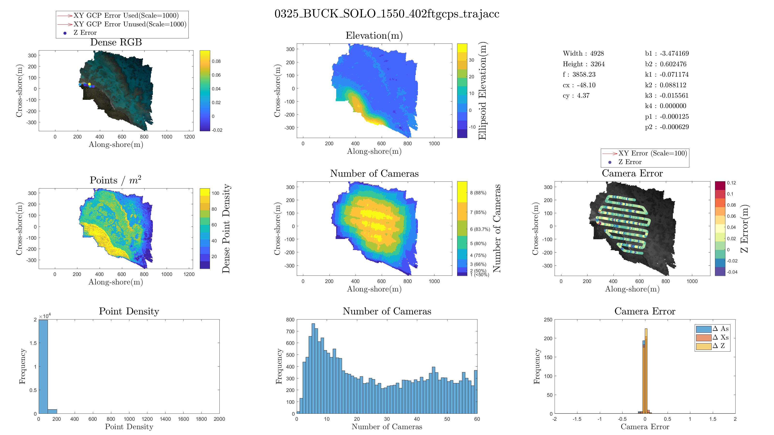
Process with correct camera accuracy setting in Photoscan
Data was processed be setting:
“Low” camera accuracy (10m)
“High” camera accuracy (0.1m)
Error propagates from:
Initial Error in keypoint matching
To Errors in Camera position
To an Error in Bathymetry Elevation
Low Accuracy
High Accuracy

Slide 4
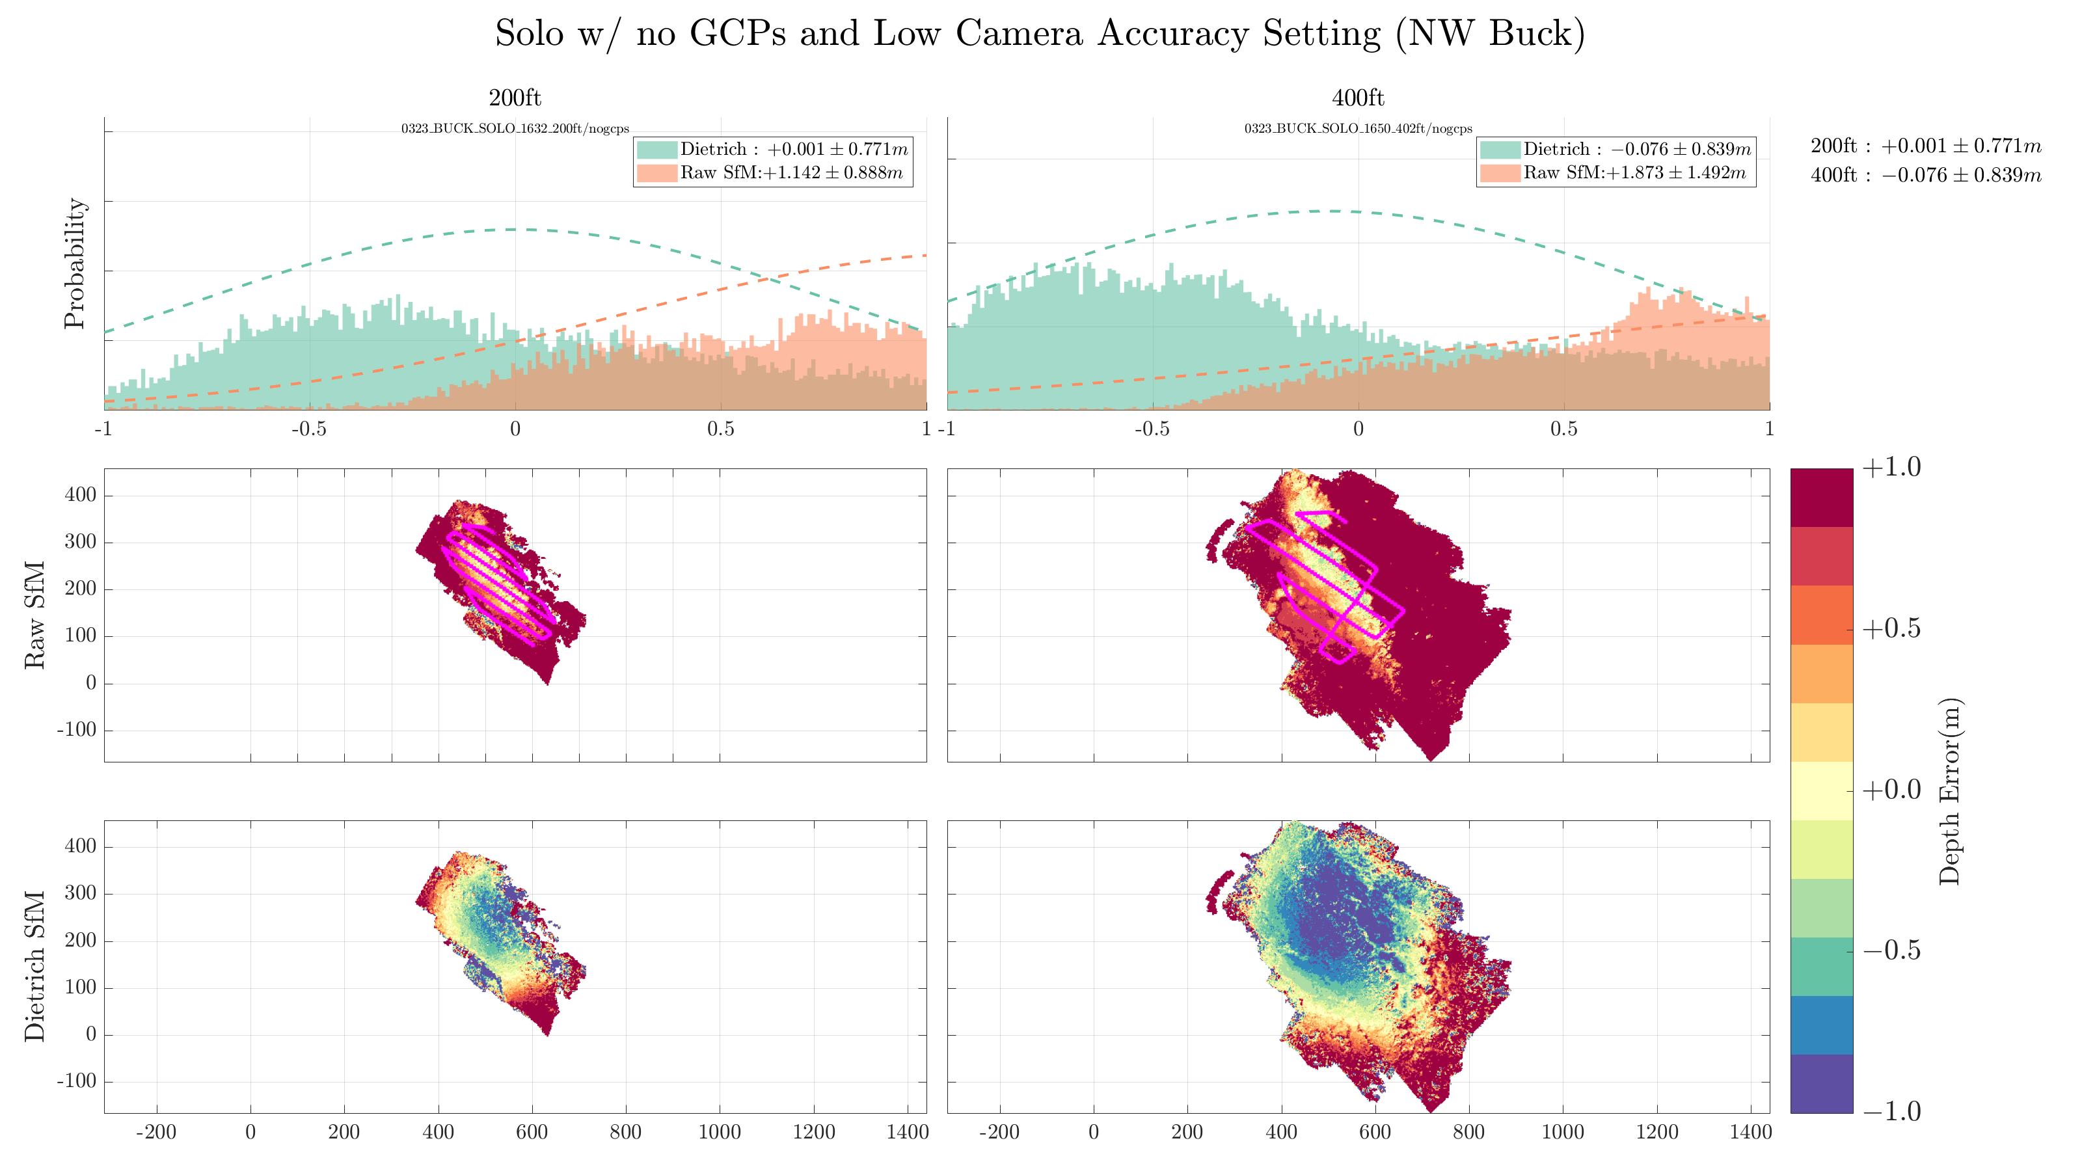
Another Example of “Low Accuracy” Bowl Effect

Slide 5
GSD
Smaller GSD == less completeness

Slide 6
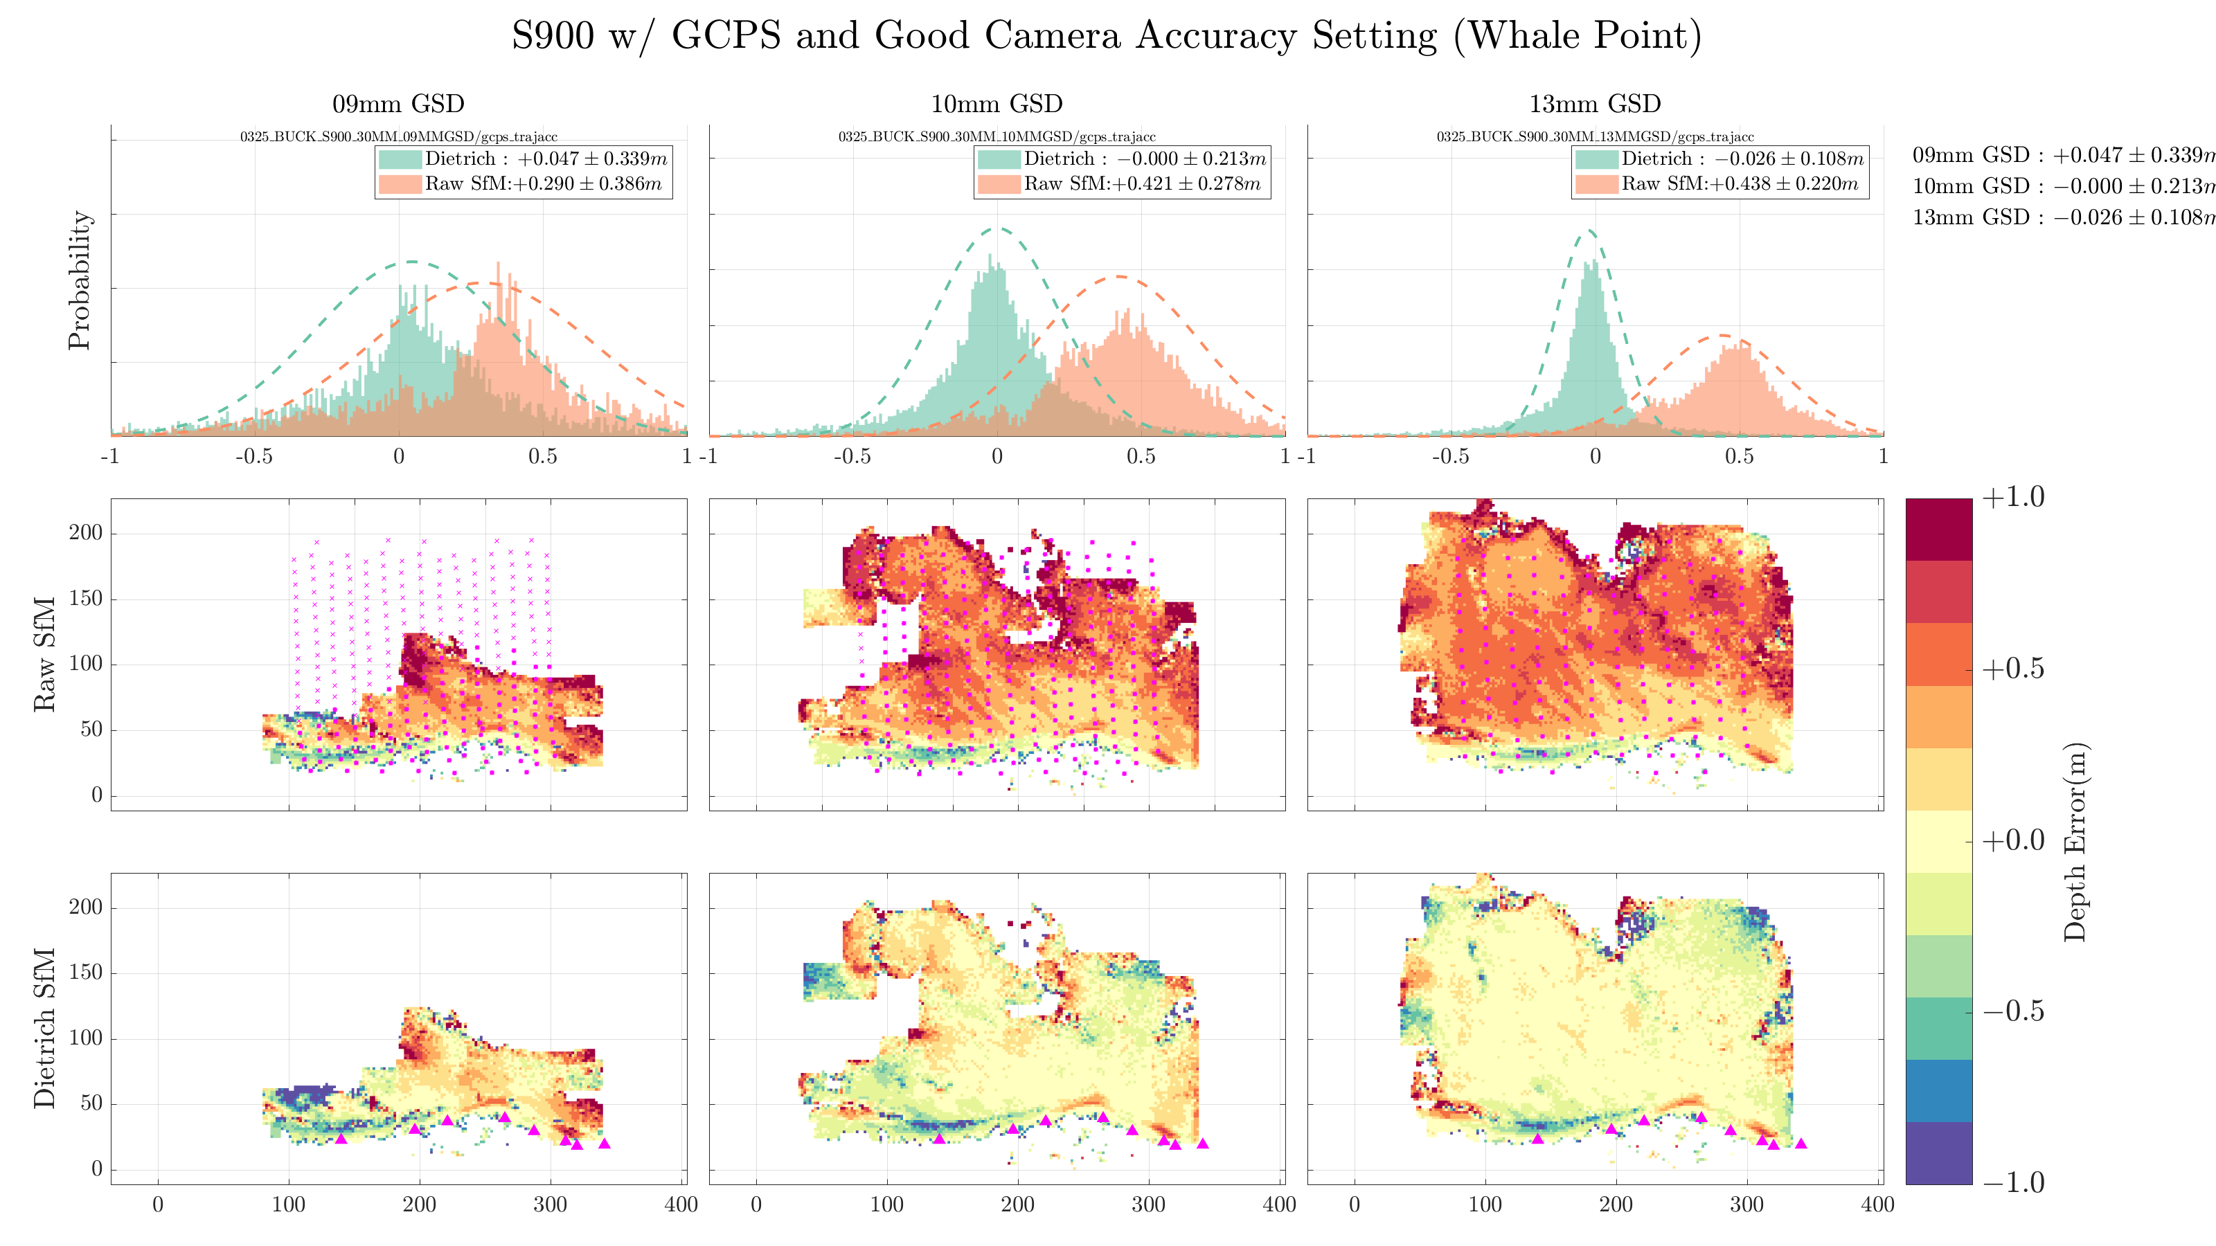
Smaller GSD == Less matched images (sometimes)

Slide 7
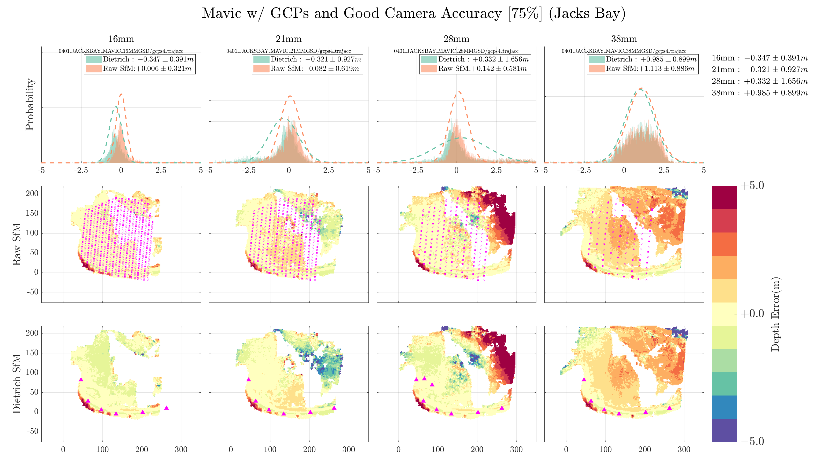

Slide 8
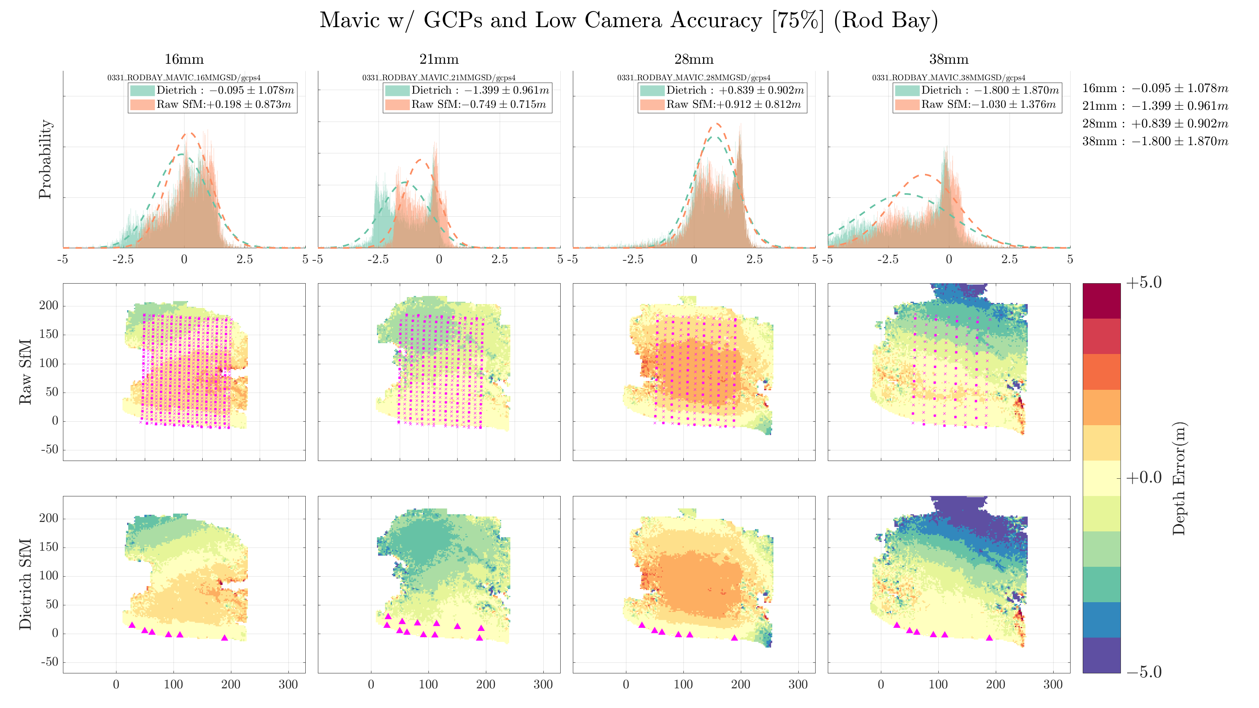

Slide 9
Focal Length
Only one set of flights for comparison…
30mm missed many of the offshore flightlines
Hard to make any comparisons here
*Maybe longer focal length has smaller variance of error (which simUAS predicted)
** but it only has points close to shore, which are more accurate for all datasets

Slide 10
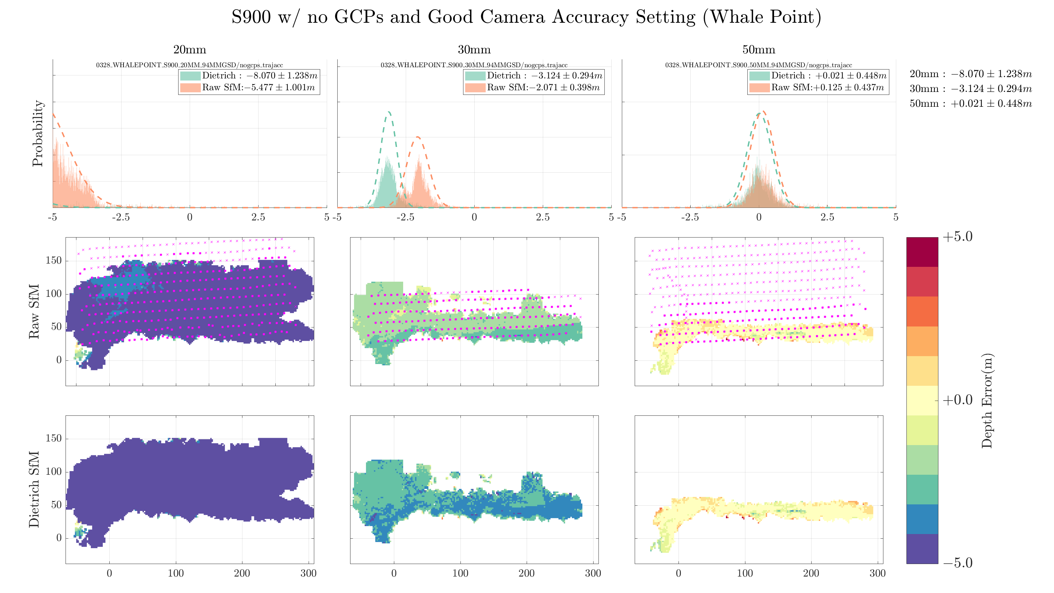

Slide 11
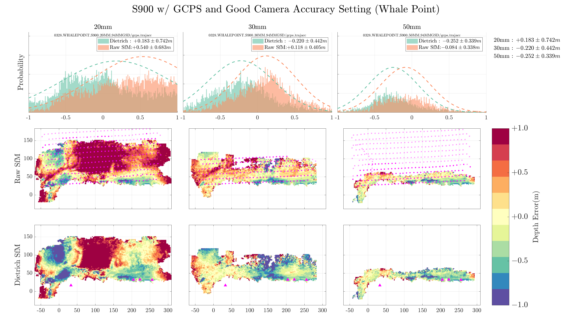

Slide 12
Overlap/Sidelap
Can’t say much about accuracy (Since all Mavic data is so bad)
50% overlap consistently has less completeness

Slide 13
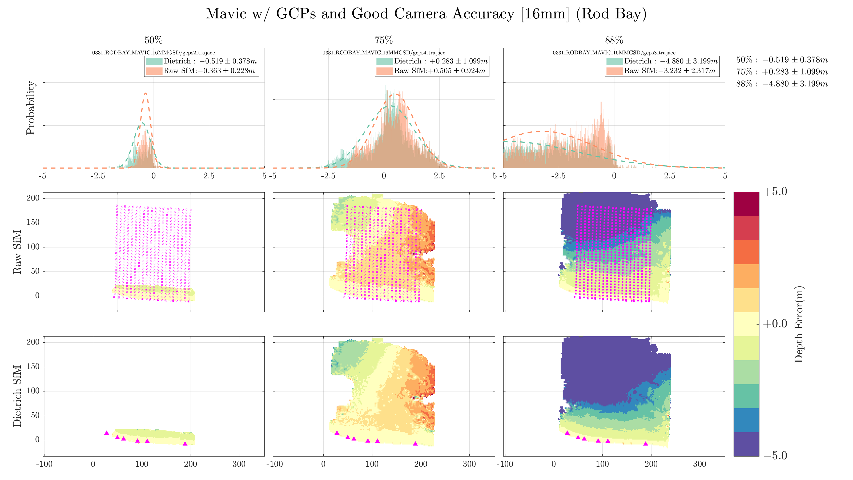

Slide 14
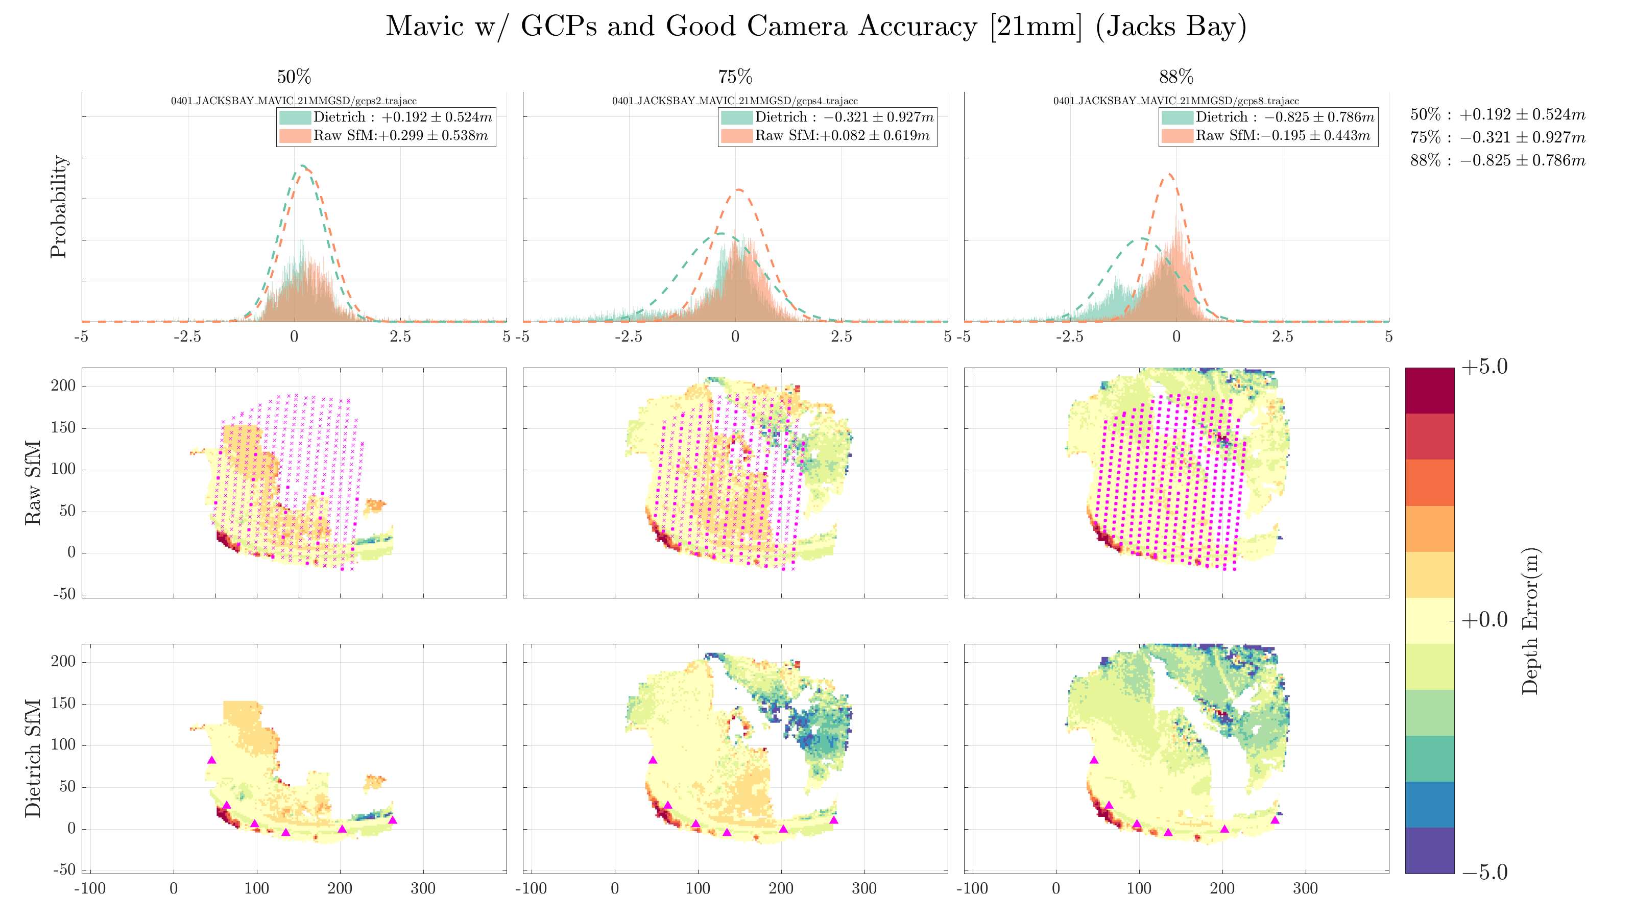

Slide 15
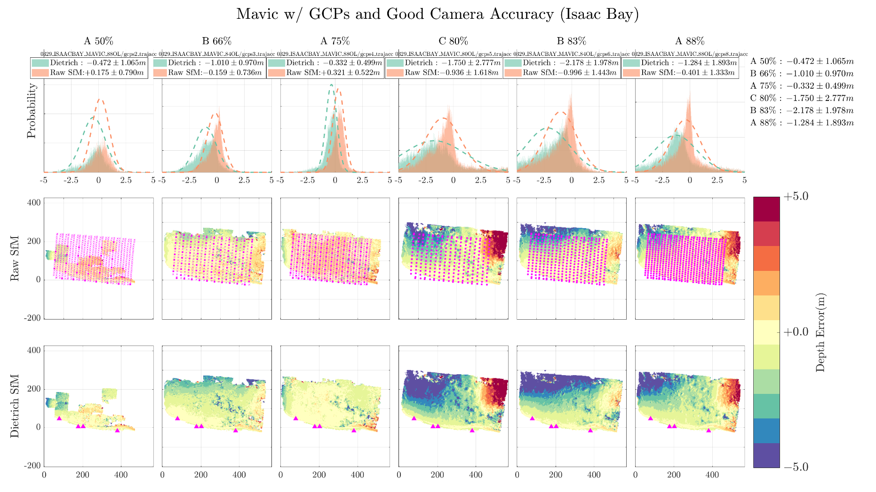

Slide 16
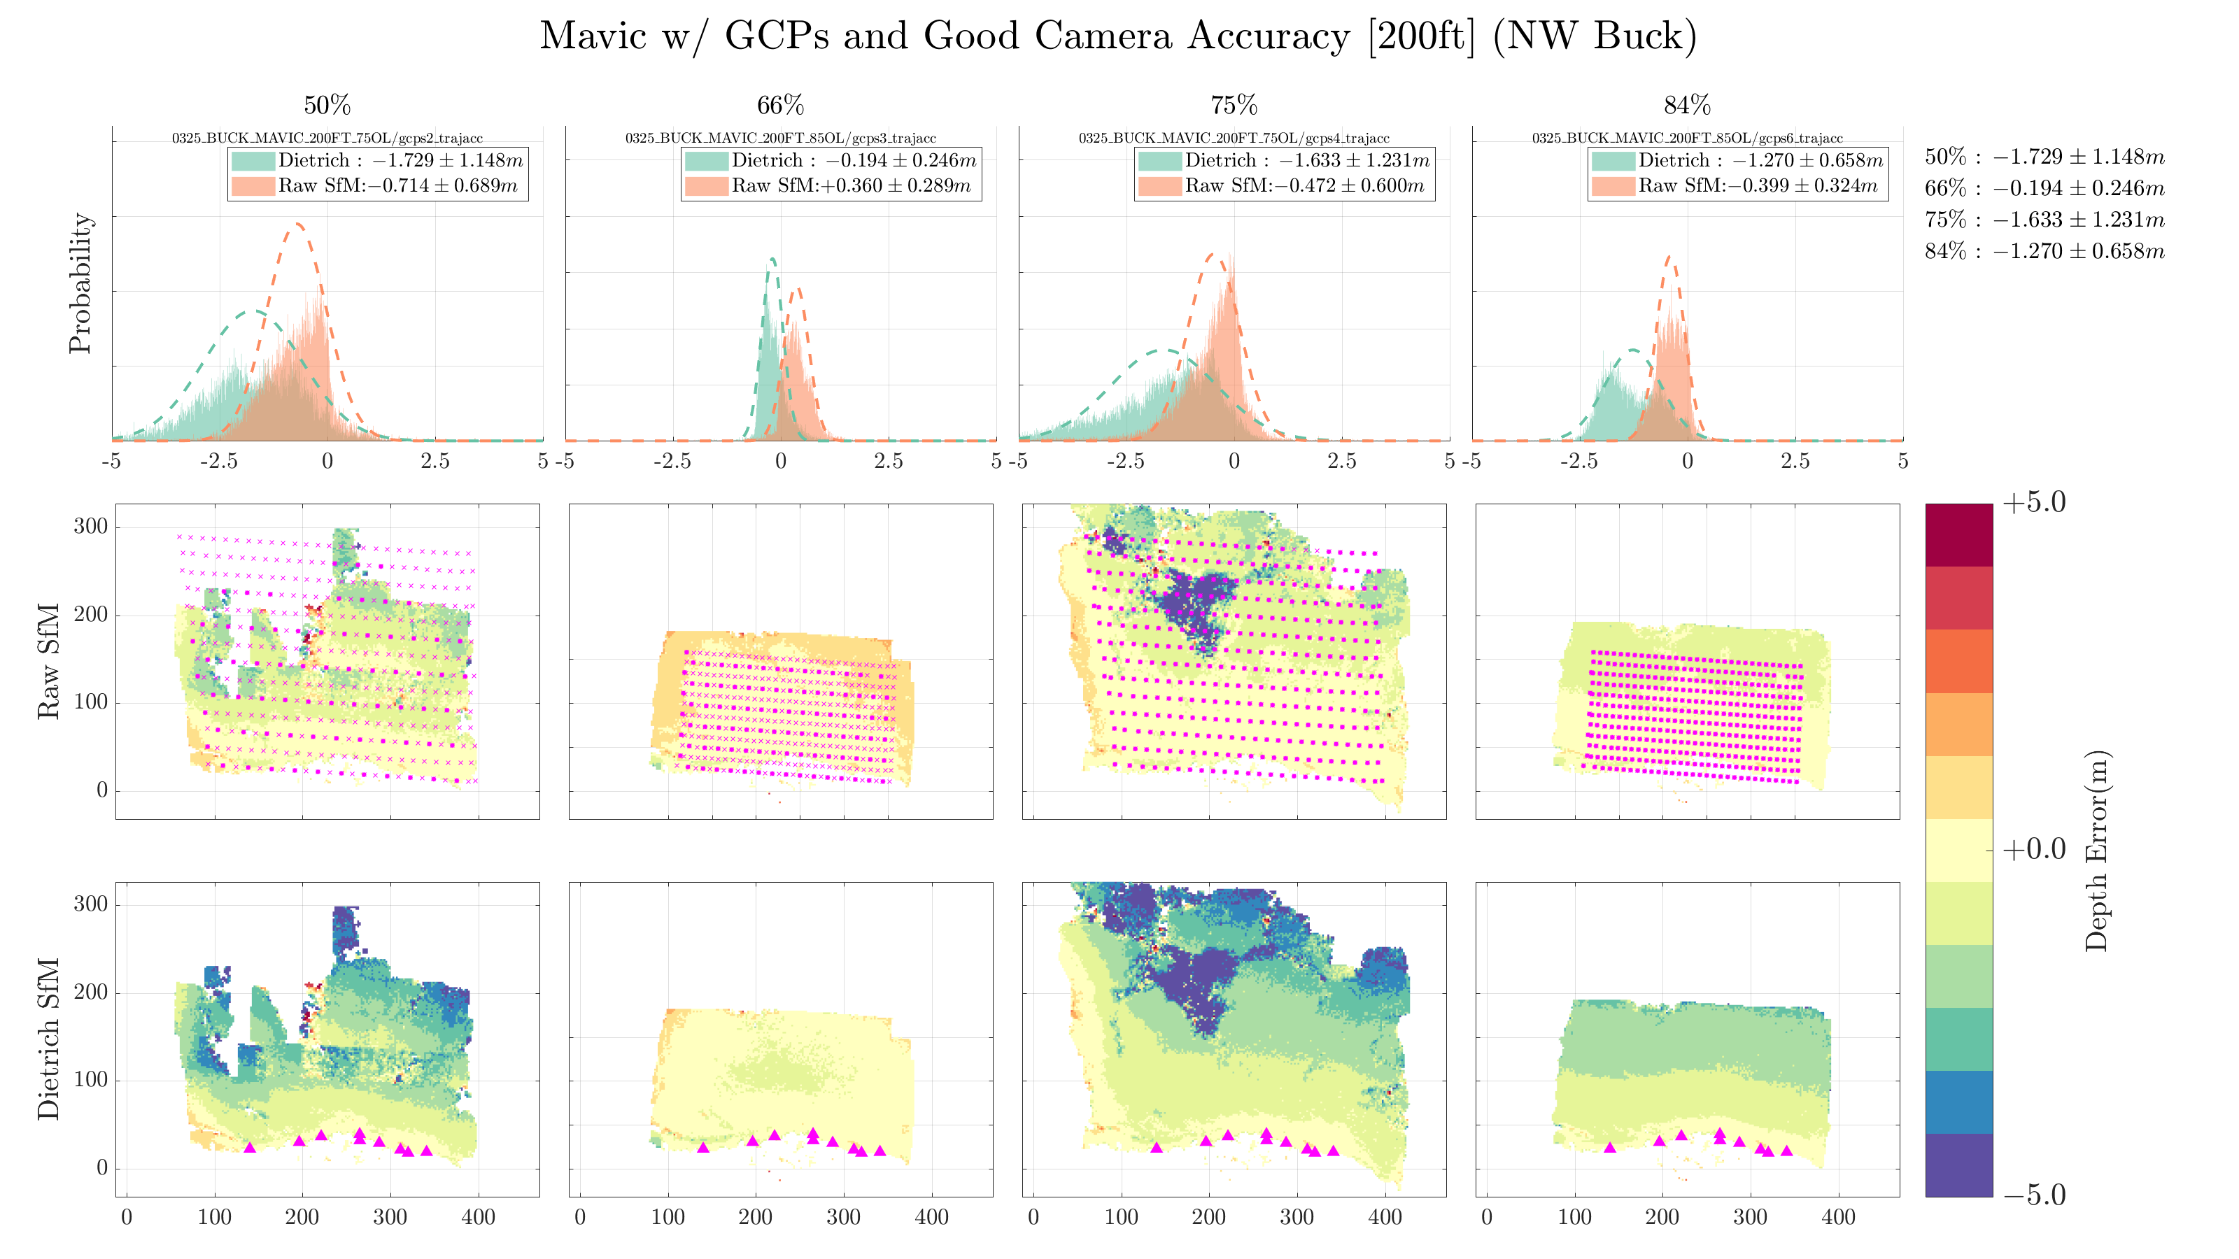

Slide 17
Oblique
0,5,10,15 degree tested at two locations
- Hard to make conclusions, given data was all from Mavic…

Slide 18
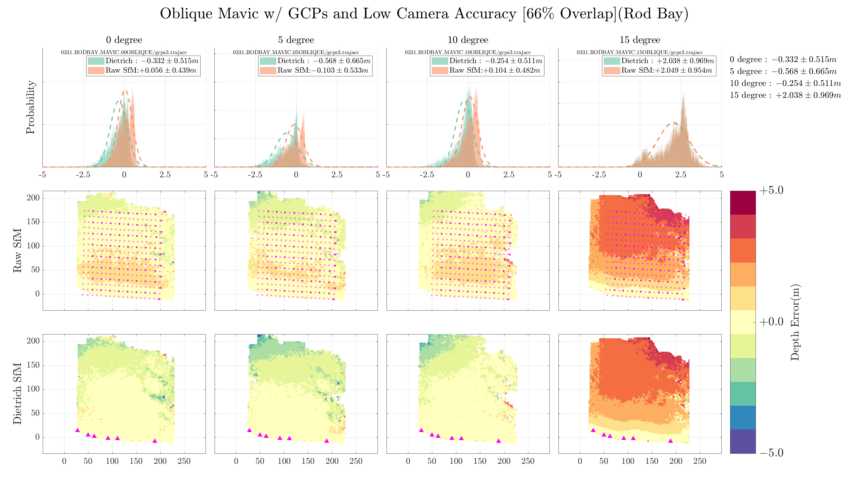

Slide 19
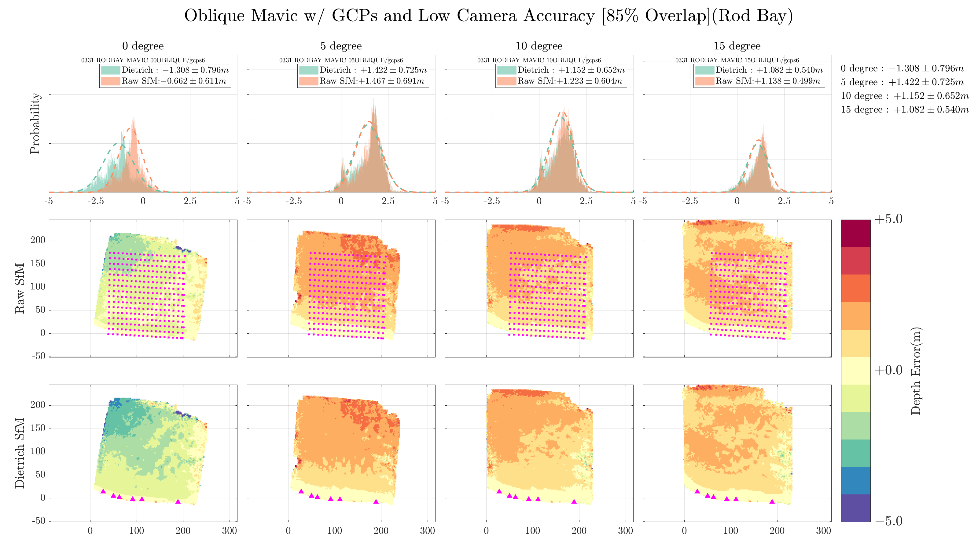

Slide 20
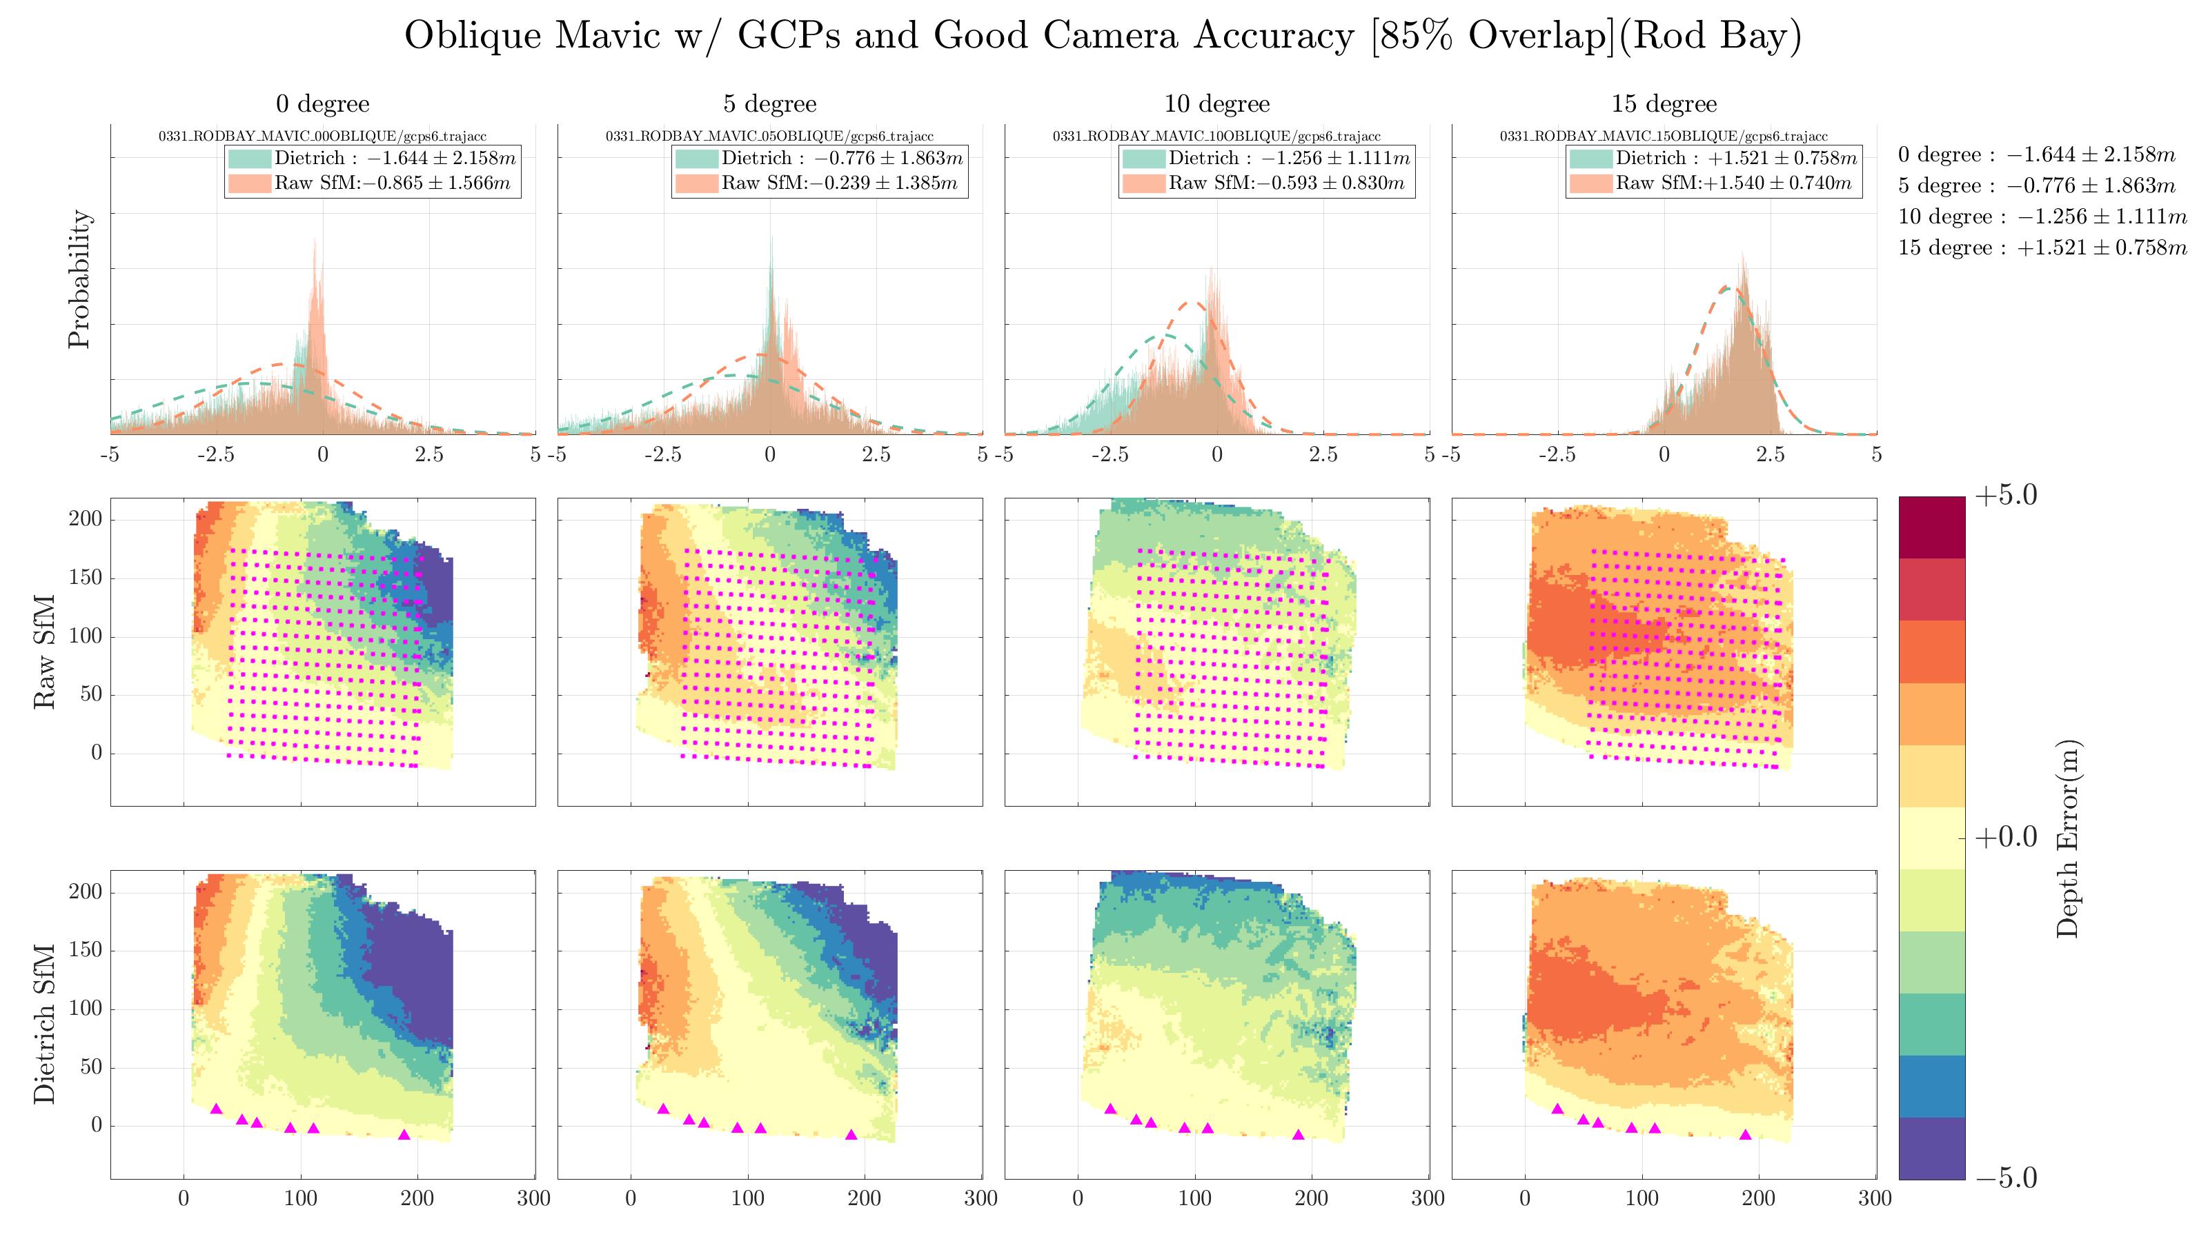

Slide 21
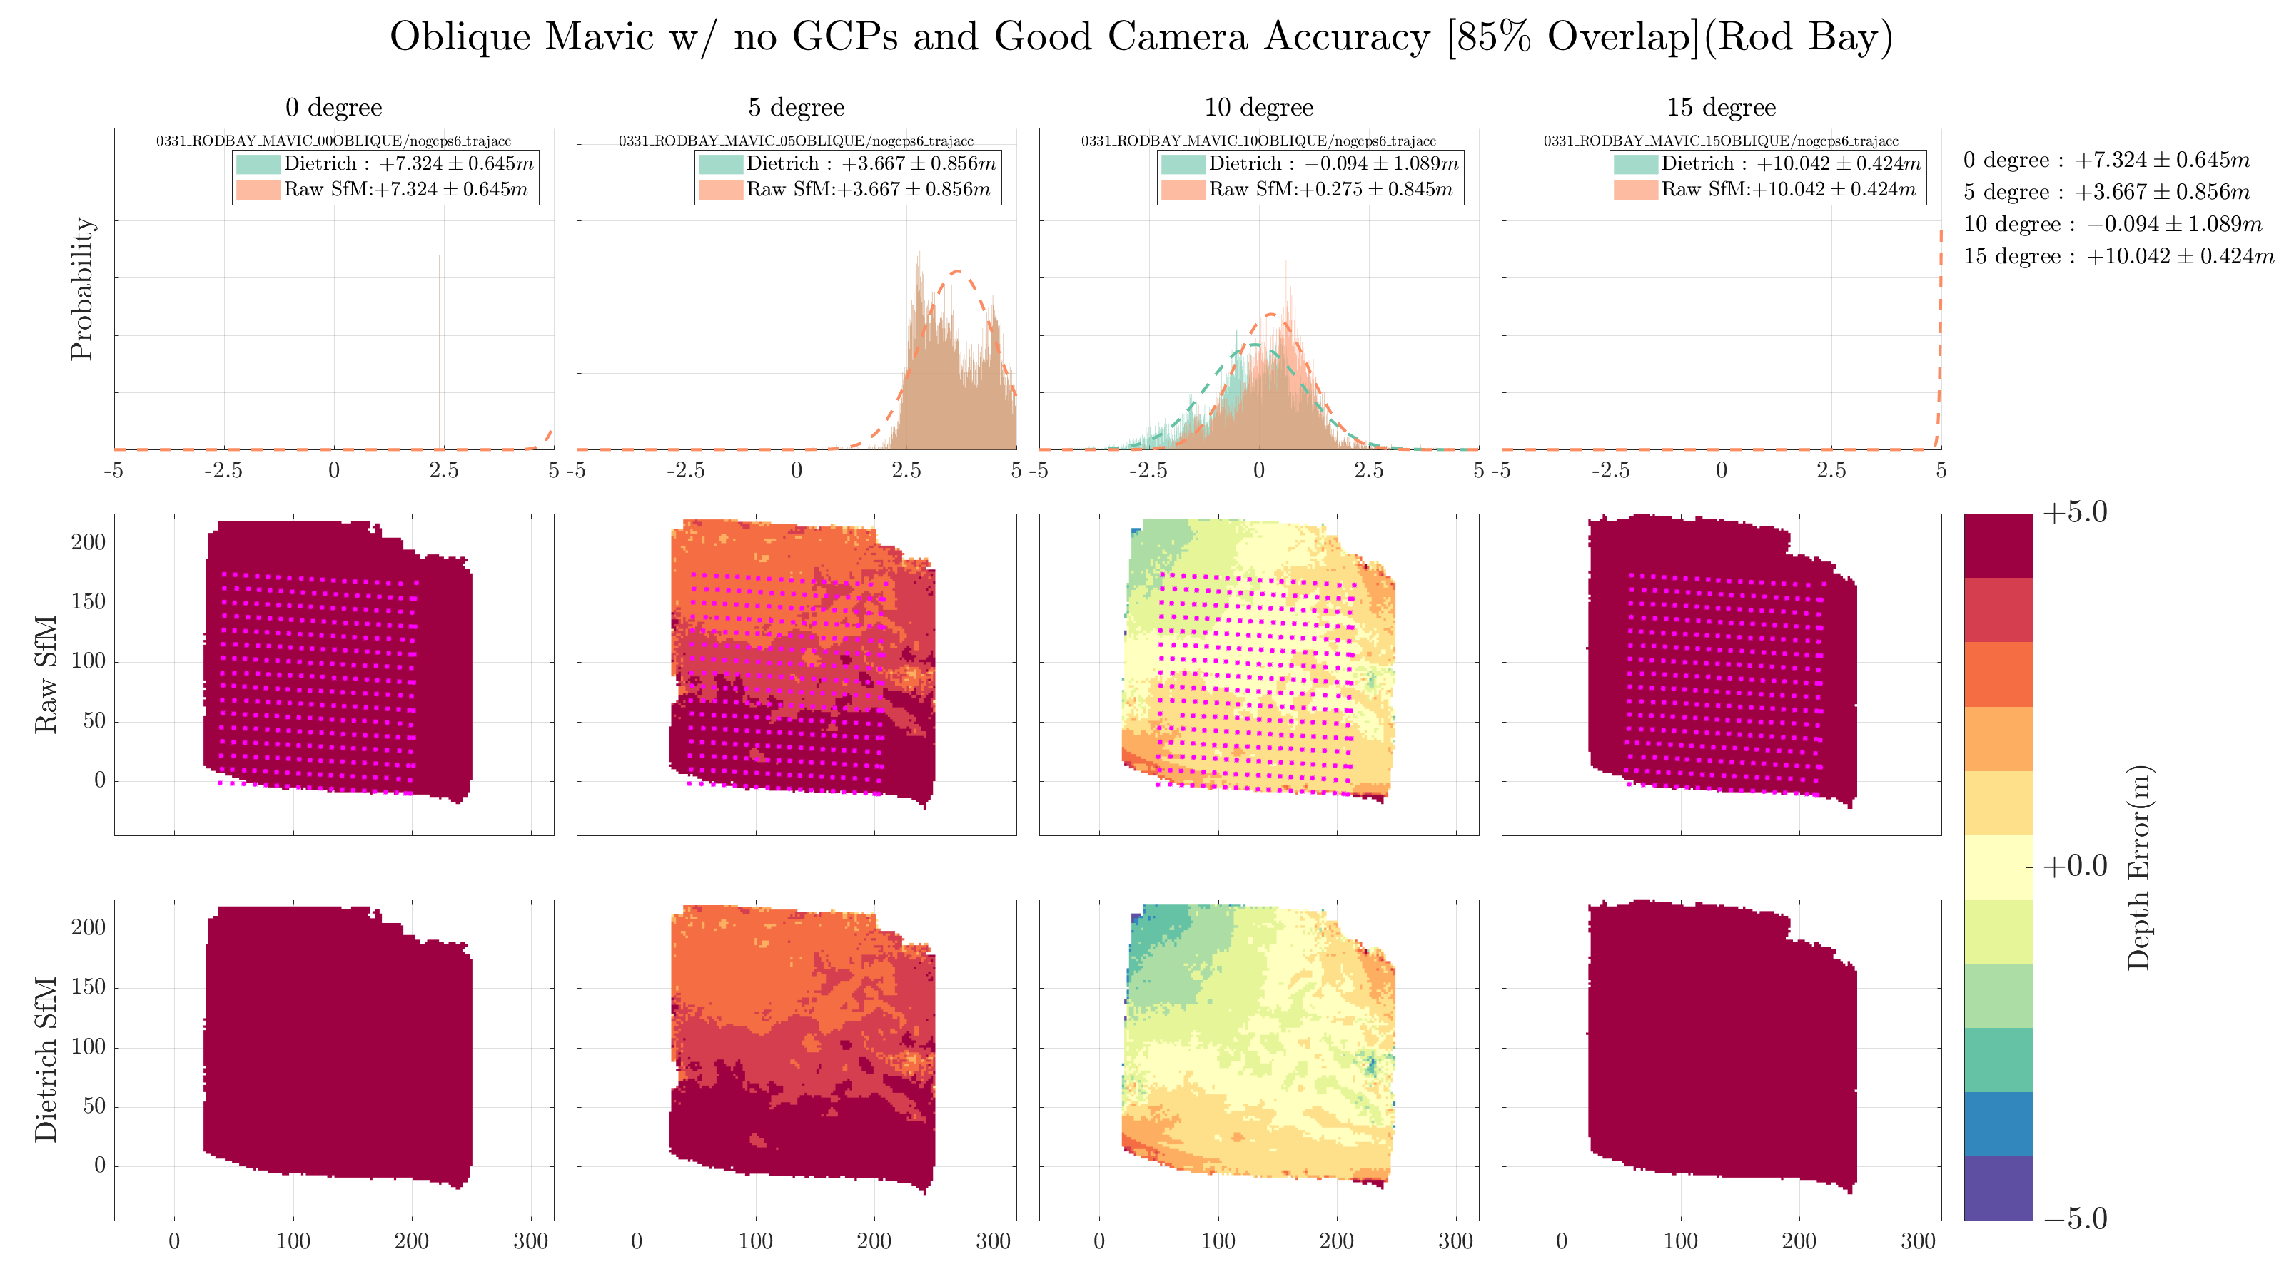

Slide 22
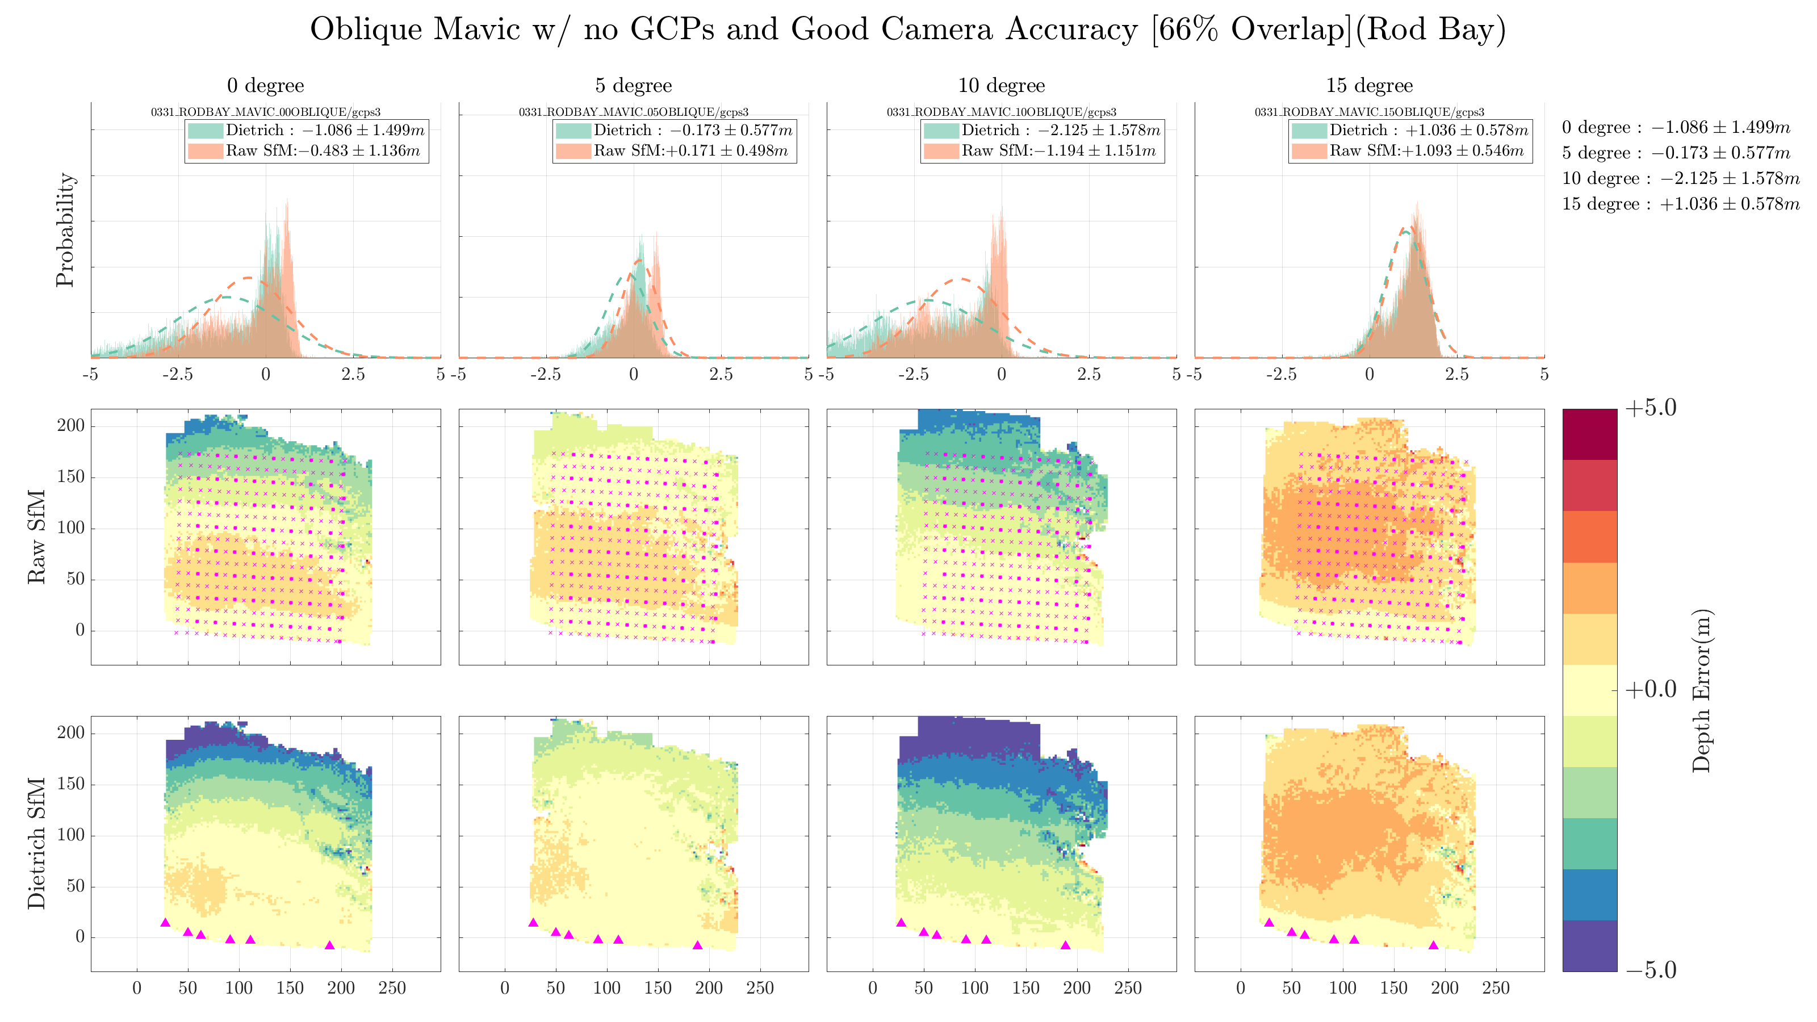

Slide 23
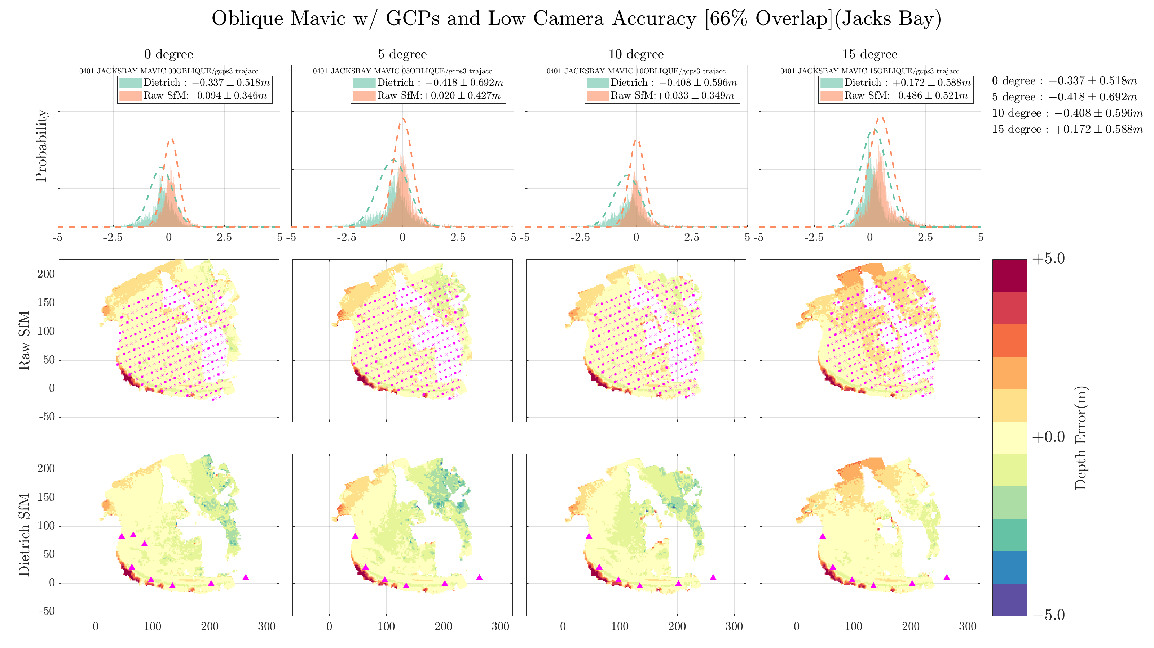

Slide 24
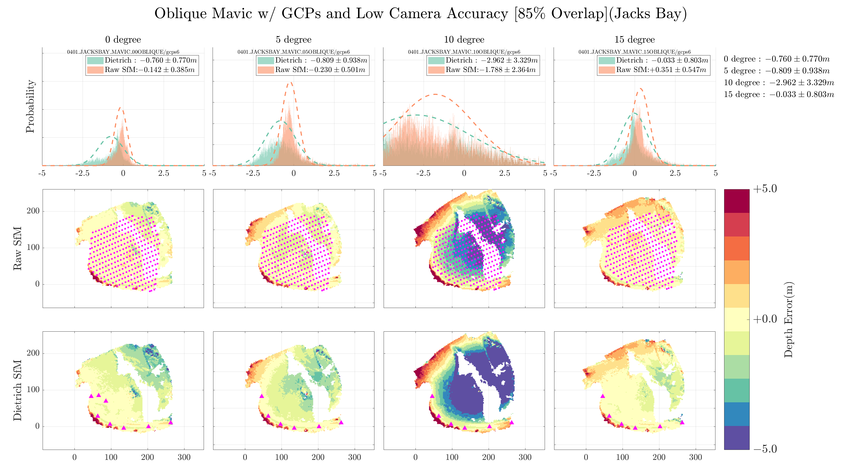

Slide 25
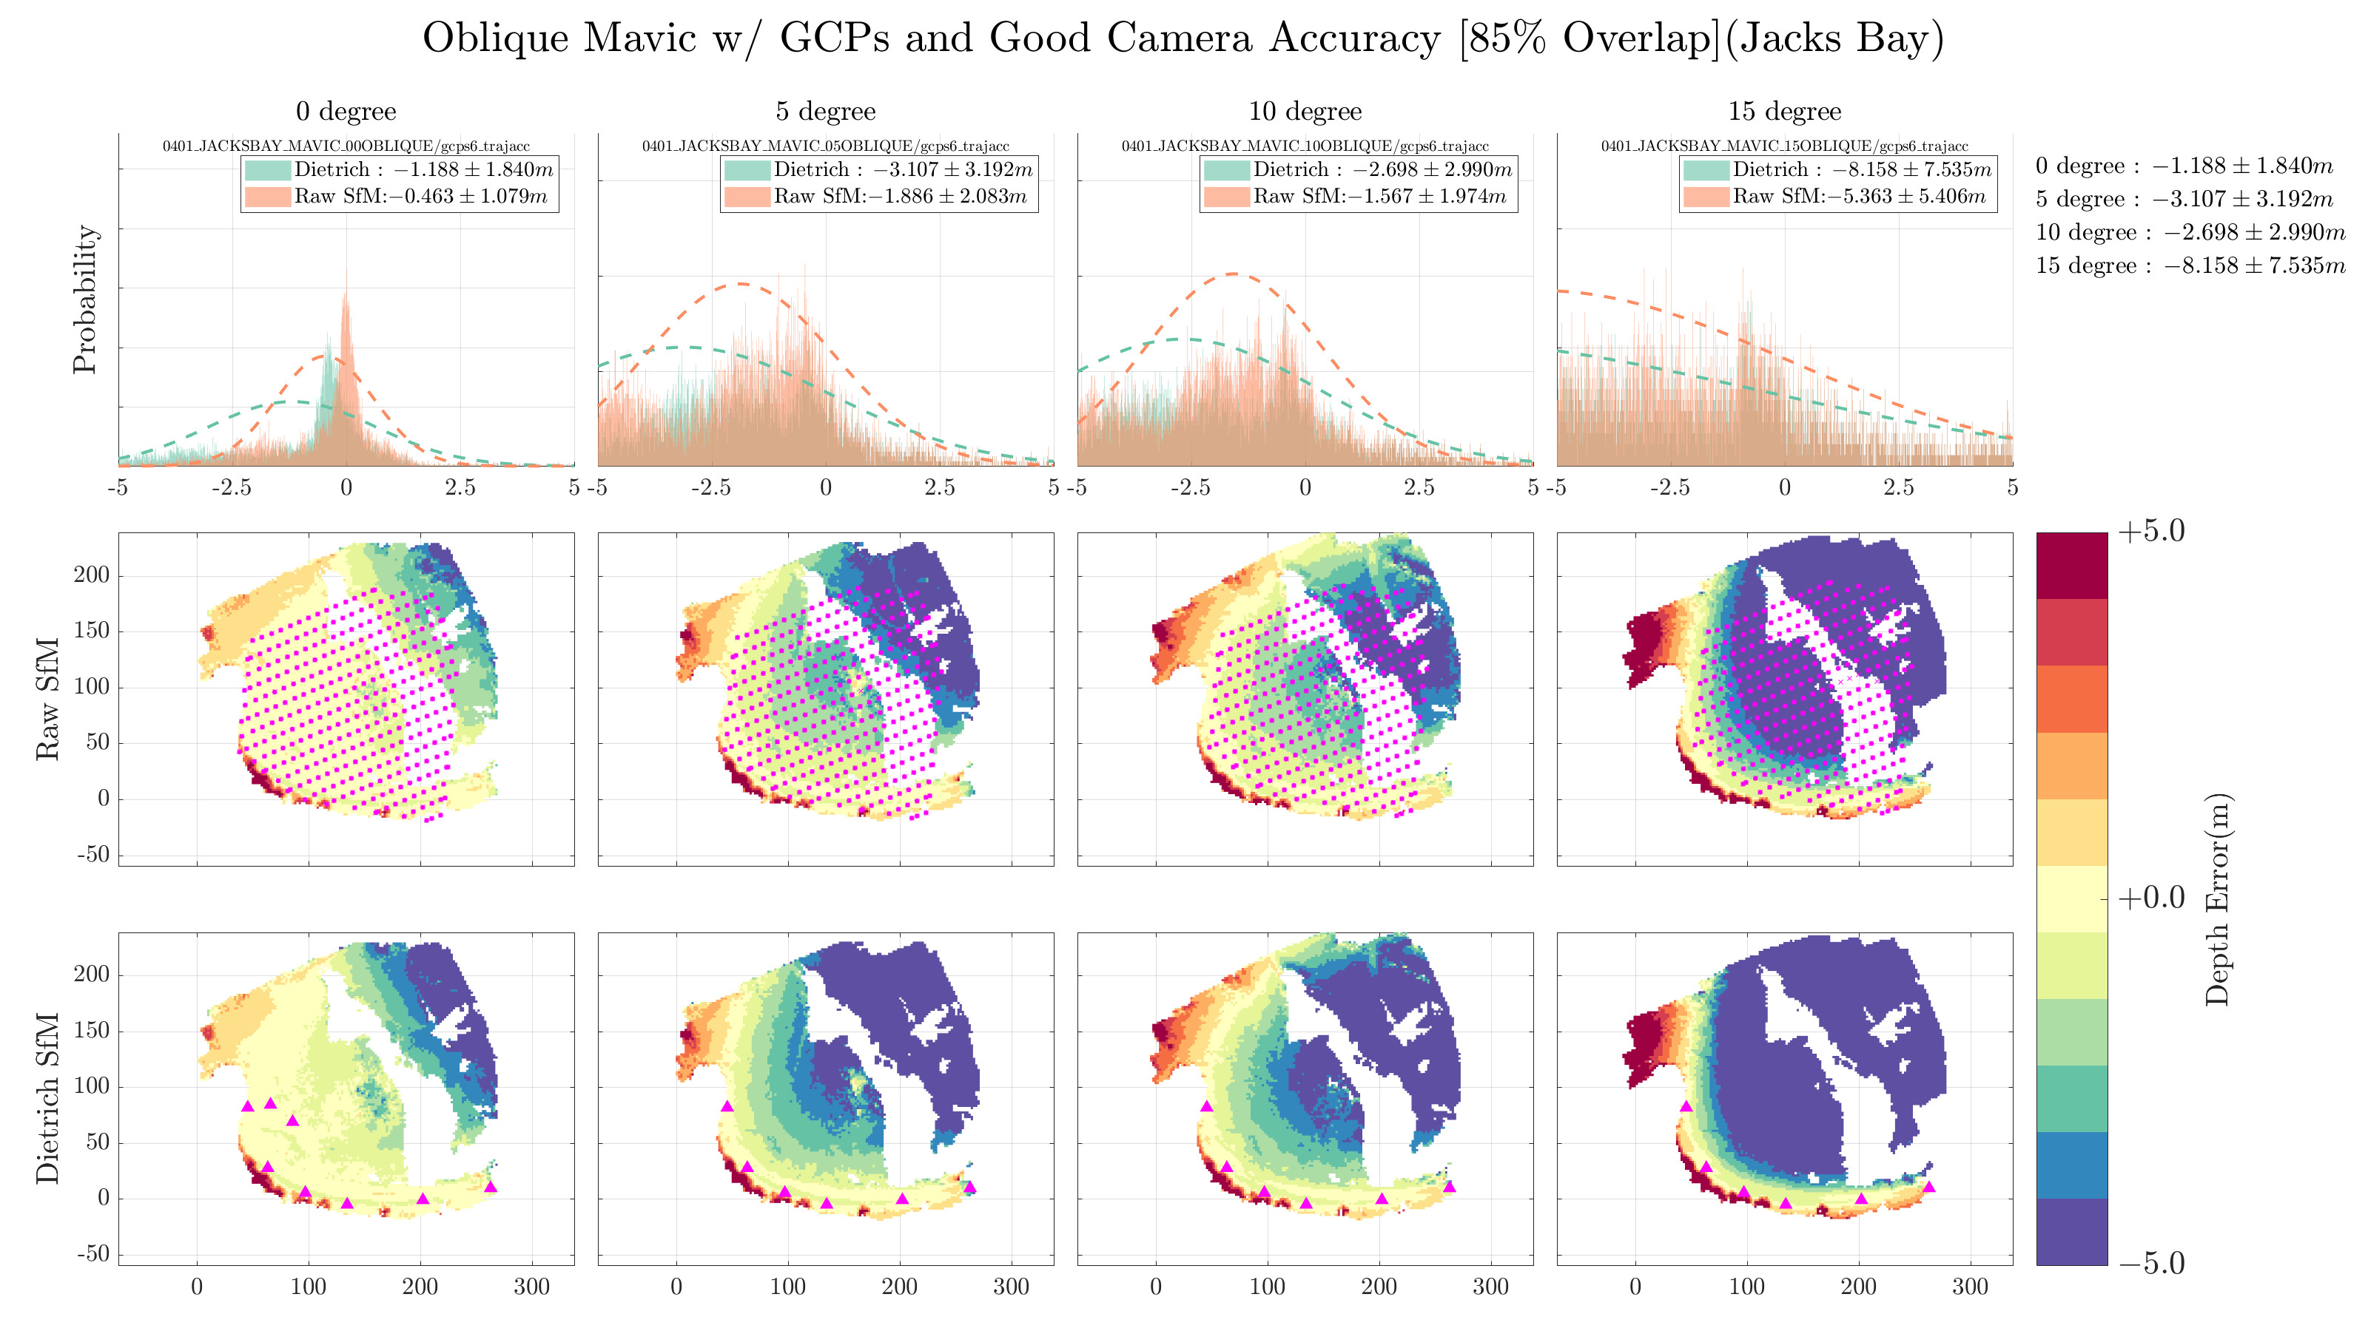

Slide 26
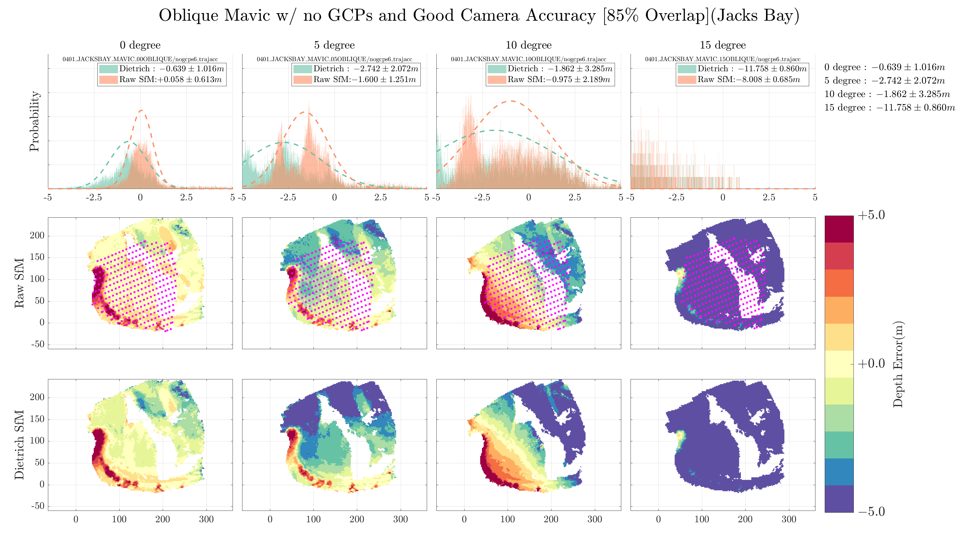

Slide 27
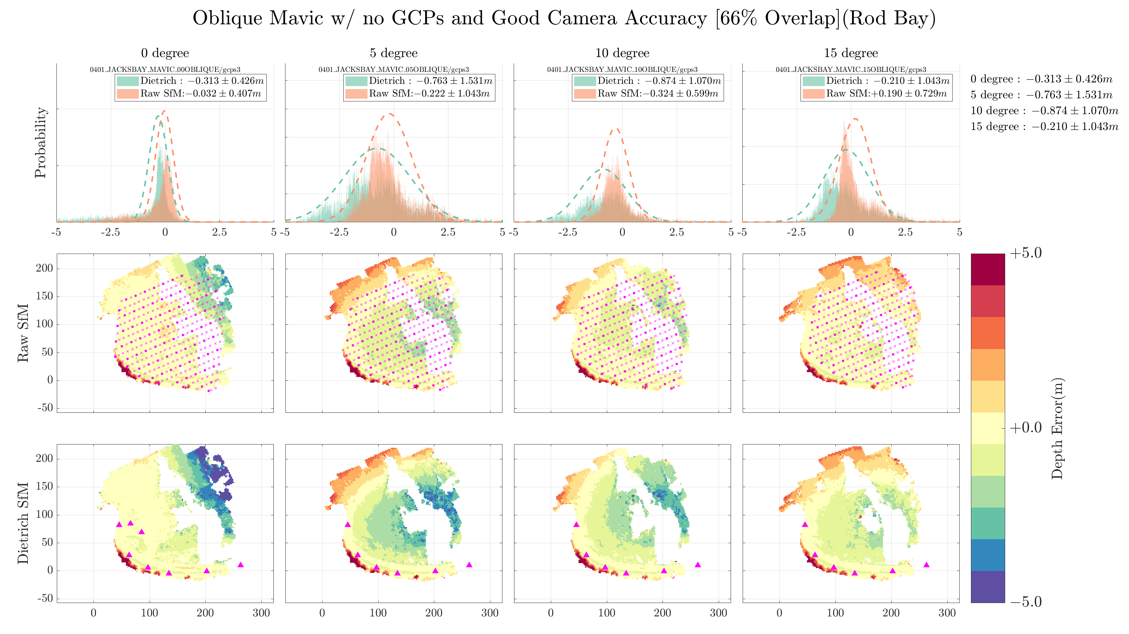

Slide 28
No Land in PPK Solo
Without land in the imagery, there are significant errors

Slide 29
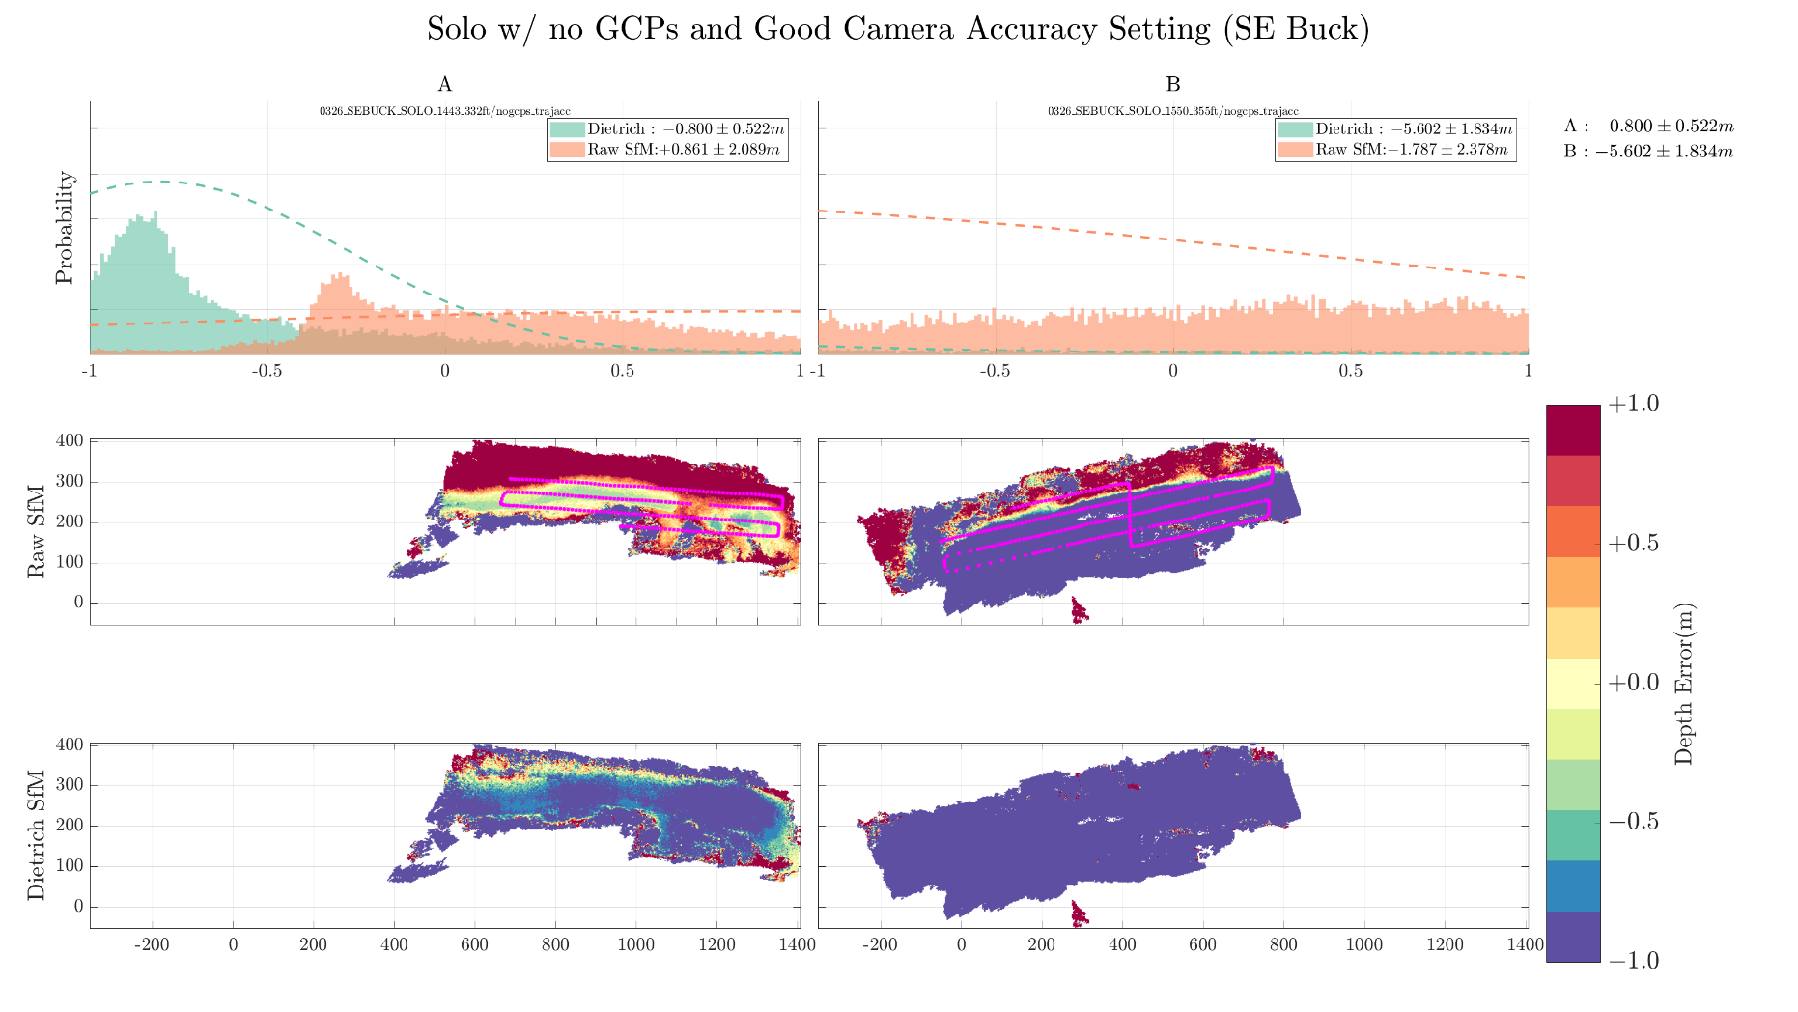

Slide 30
Repeat Solo
Good repeatability with PPK

Slide 31
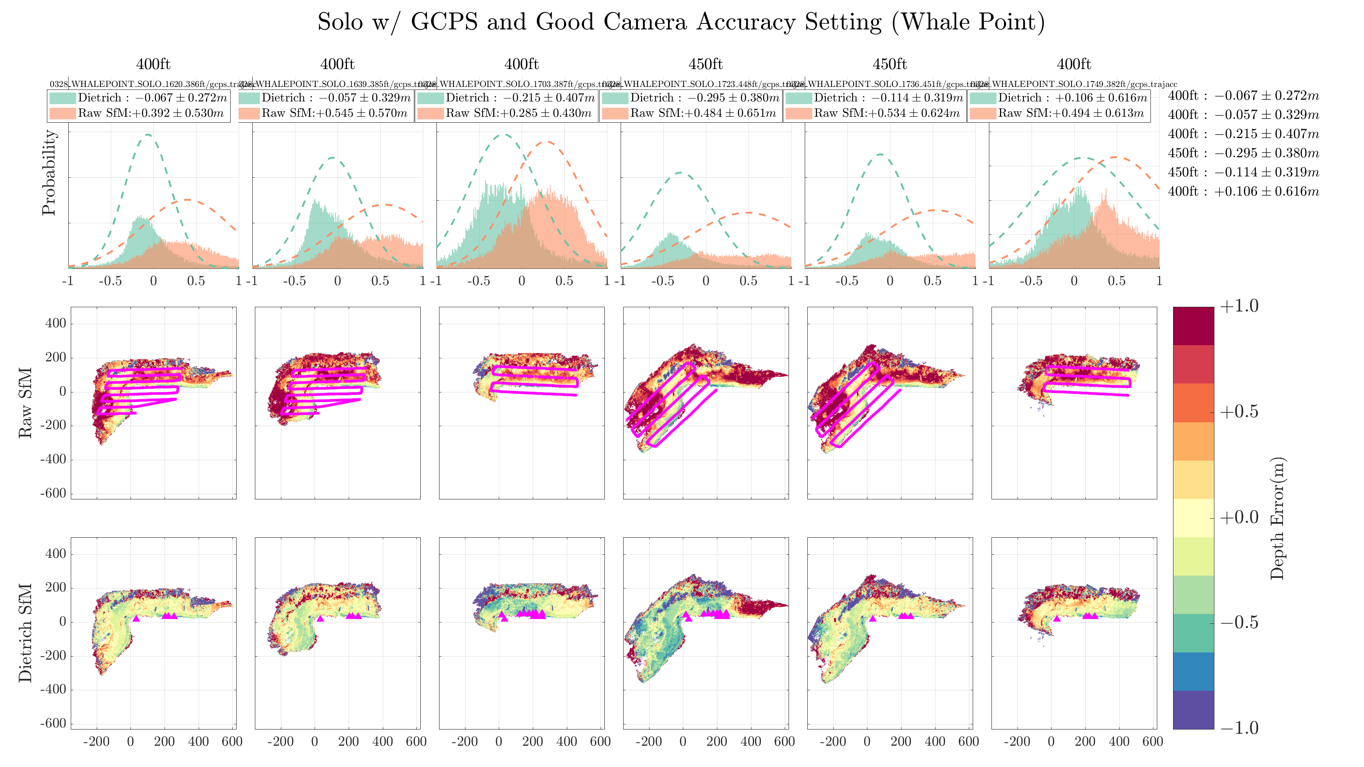

Slide 32
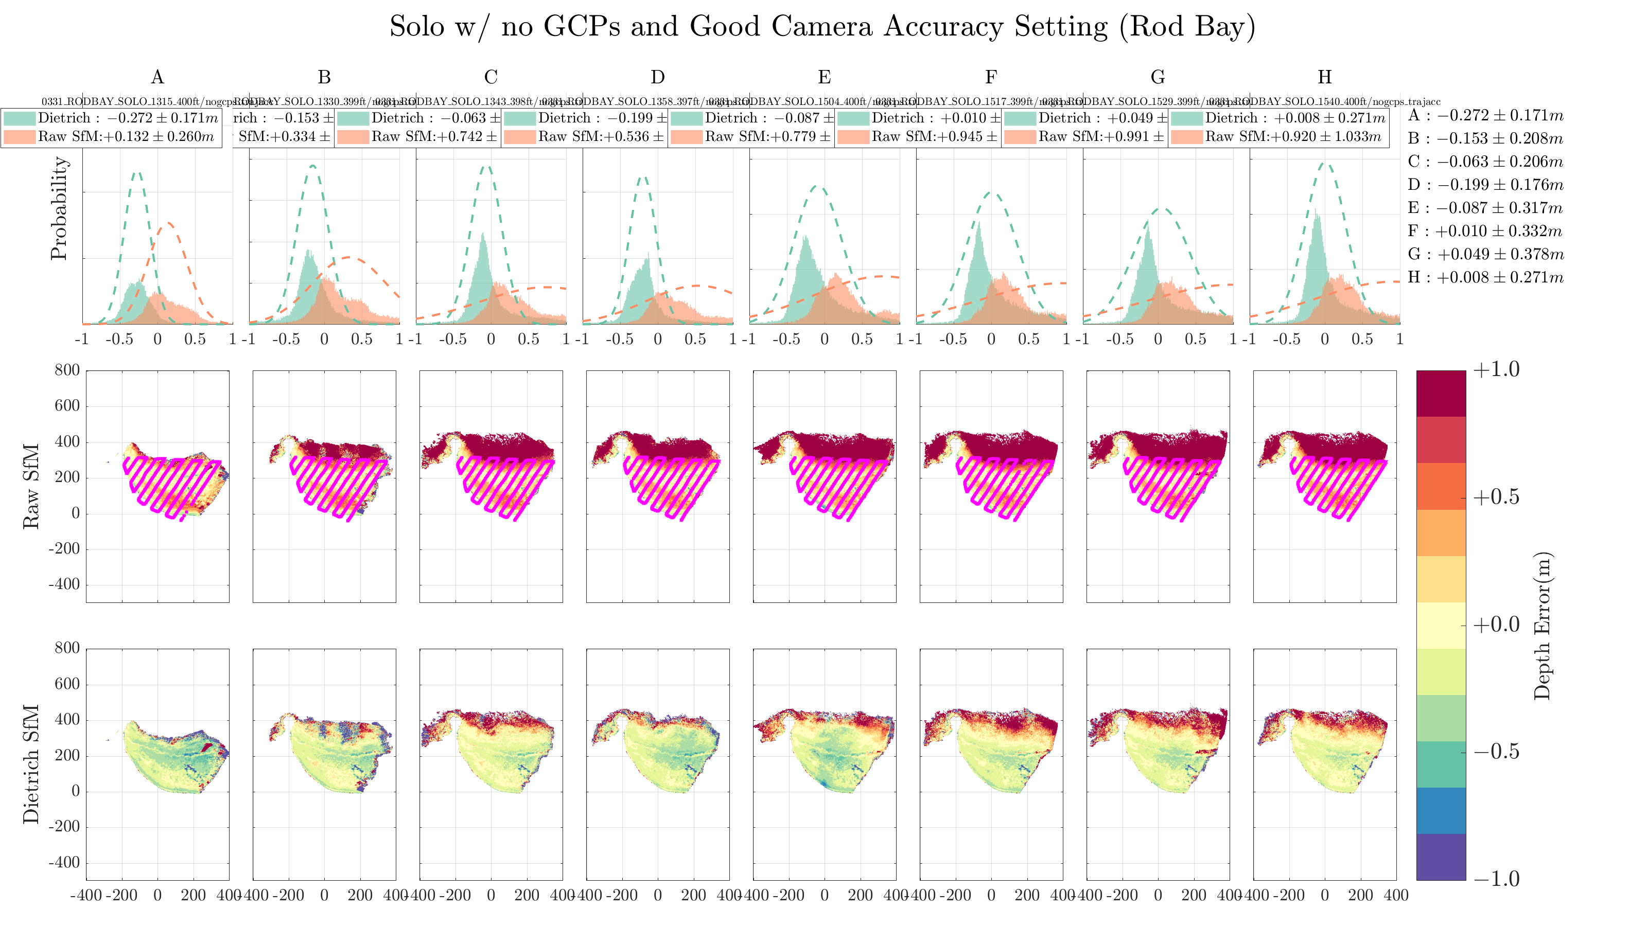

Slide 33
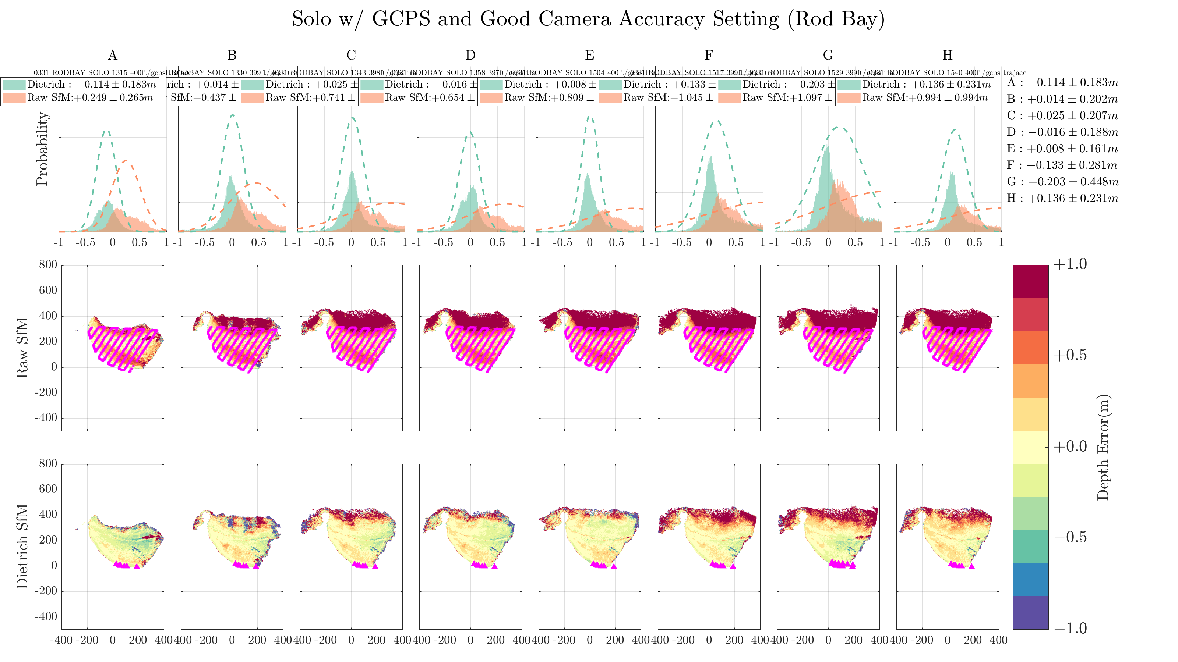

Slide 34
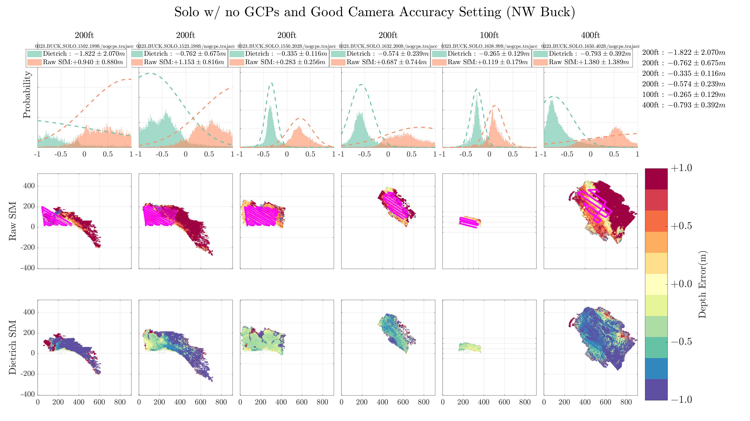

Slide 35
